Slide 1
Flight Price Prediction
Submitted by Utsav Rastogi

Slide 2
Problem Statement
This project meant to help understanding the various factors at play when predicting the price of flights from and to major cities.
Mine flight data from a travel website to and from different cities in India.
Build a machine learning model to analyse the dataset.
Perform EDA to gain insights and make observations.
Predict the flight price using the input features.

Slide 3
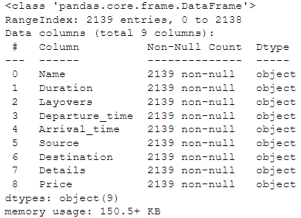
Data source
Data is mined from “Yatra.com” from various flights having major cities as source and destination.
Total of 2139 samples were mined.
Data mined:

Slide 4

Testing of Algorithms
1. Lasso Regression
2. Decision Tree Regressor
3. Random Forest Regressor
4. XGB regressor

Slide 5
Models
Model | Score
Decision Tree Regressor | 44.676337881779304
Random Forest Regressor | 44.676337881779304
Lasso Regression | 38.361184528699674
XGB Regressor | 70.65154124703409
R2 Score:
Cross Validation Score:
Model | Score
Decision Tree Regressor | 5.694688746255702
Random Forest Regressor | -43.097194856804045
Lasso Regression | 8.440088154115239
XGB Regressor | -32.231021461641305

Slide 6
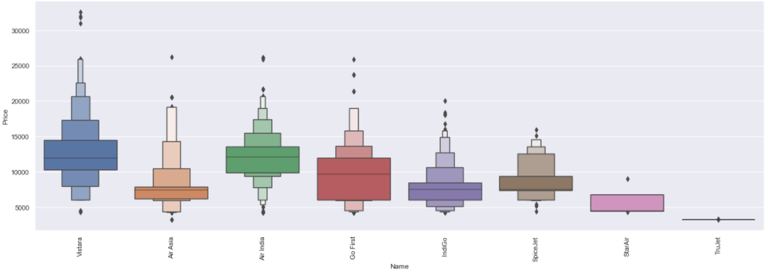
Visualizations

Slide 7
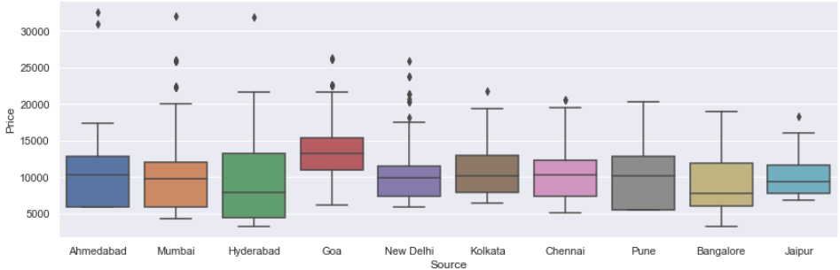
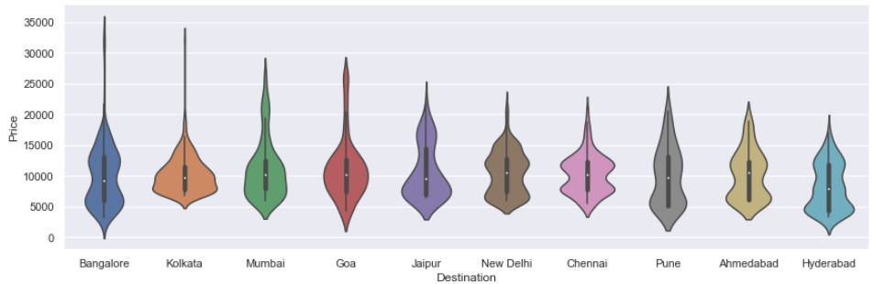

Slide 8
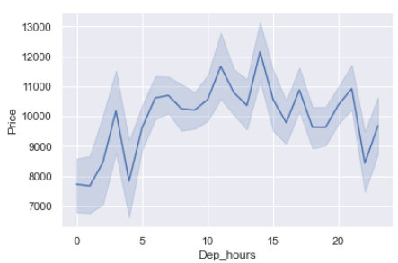
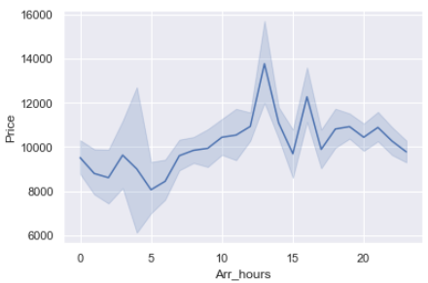
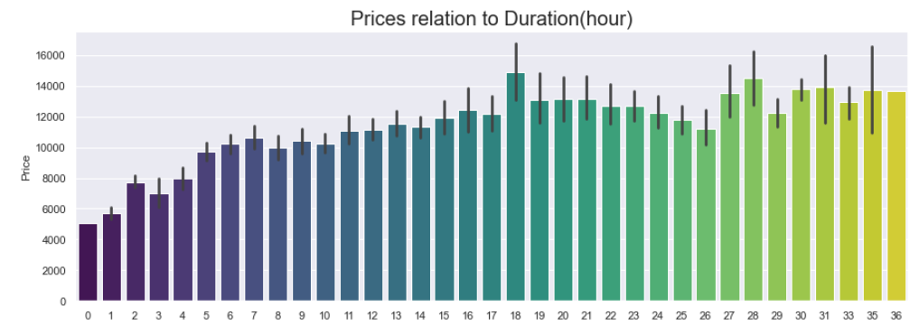
Bivariate Analysis:

Slide 9
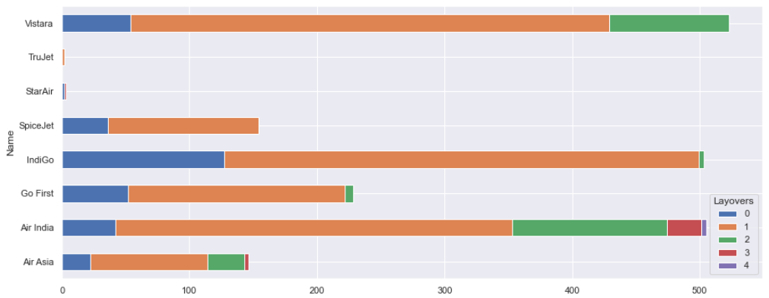
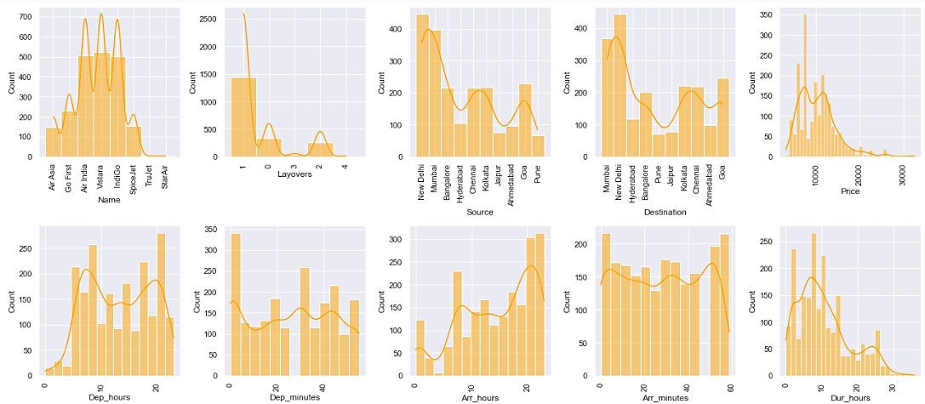
Feature distribution:

Slide 10
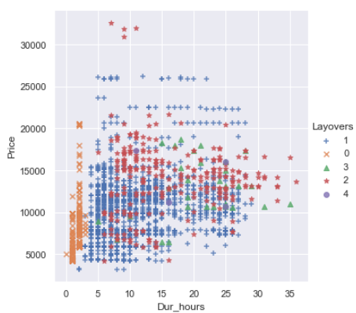
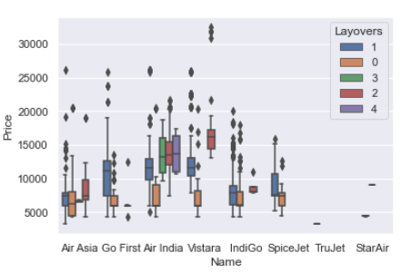
Multivariate Analysis:

Slide 11
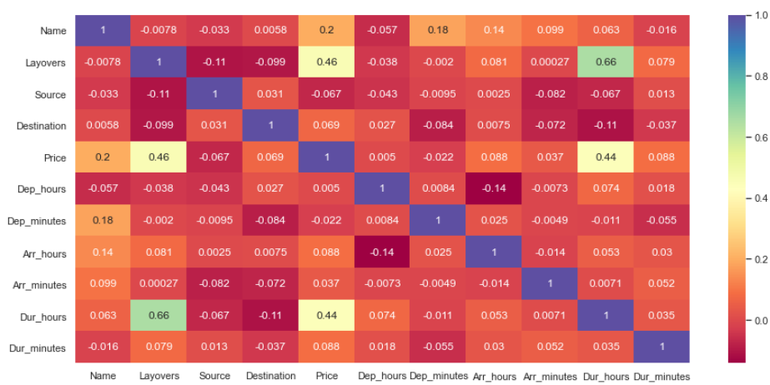
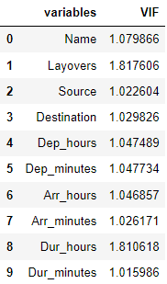
Correlation Heatmap

Slide 12
conclusions
Vistara, Air India and Indigo offers the flights to majority of the destinations.
New Delhi and Mumbai are top destinations searched.
Majority of the flights originate from New Delhi and Mumbai.
Almost 75% of the flights in the dataset have 1 stop during journey.
Majority of the flights cost less than 15k rupees.
Less number of flights depart early morning (before 5am).
Almost half the flights reached in the late evening and night (after 6pm).
Most of the flights have a duration of less than 12 hours.
Vistara have the most expensive flights with air India at the second spot.
Vistara and Indigo have the most “1 stop “layovers.
Indigo also operated the largest non-stop flights in India.
Air India has the maximum number of “2 stop” layover flights with Vistara coming in at second place.
Air India is also the only carrier to operate flights having 4 stops and is also the major operator of 3 stop flights.
Hyderabad as the destination have the cheapest flights.
Bangalore and Kolkata as destinations have the most expensive flights.
Flights from Goa are usually more expensive than other cities.
Flights from Hyderabad are the cheapest among the group.

Slide 13
Conclusions (contd.)
Flights departing from 10am to 3pm have a high price tag as it’s the most convenient time to leave.
Flight arriving in the timeframe from 12pm to 4 pm are the costliest as this is also a good time to arrive in broad daylight.
Longer the duration, more expensive the flight is except flights are most expensive when the duration is around 18 hours.
1 stop layover flights disregarding the duration are always the most expensive. Some outlier 2 stop flights with lesser duration have the highest price tag.
Non-stop flights are cheaper for every airline.
Vistara’s 2 stop layover flights have a higher price compared to air India in the same category.
Go First airline charges the most for 1 stop flights among the group.
Air India’s 4 stop airline is still cheaper than Vistara’s 2 stop flight.
IndiGo has the cheapest 1 stop flight journey among its rivals.
Air Asia is the cheapest flight in the dataset.

Slide 14


